Slide 1
Race 1 Algorithm
Nick LaRosa and Nolan Sornson

Slide 2
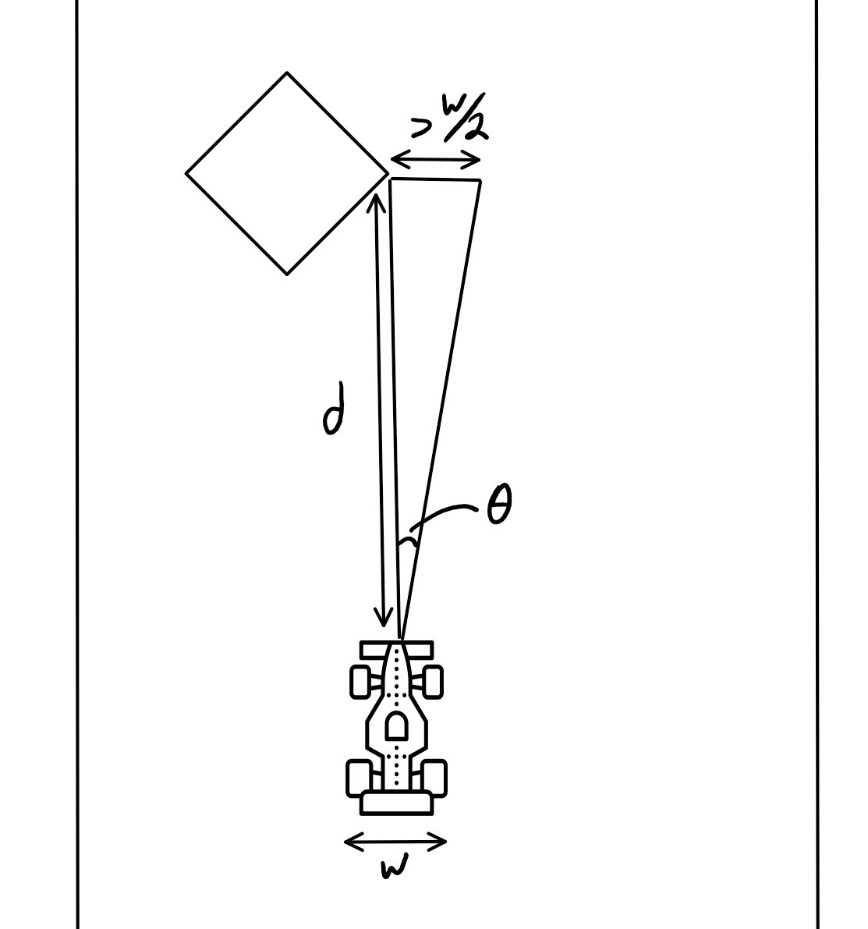
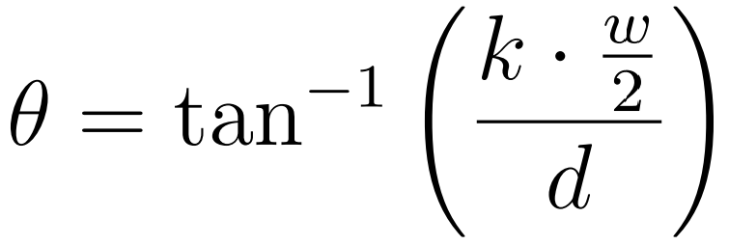
Extend Disparities
Find disparities by determining where consecutive LIDAR readings differ by greater than a threshold
Set all LIDAR indices within 土θ of all disparities to zero, where θ is given by: and k is some positive safety factor constant
This accounts for the non-zero width of the car

Slide 3
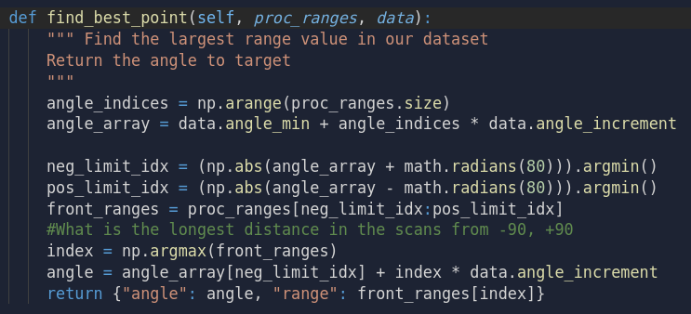
Find Single Best Point
Single Best Point
Average of Best Points
b
a
* For this to work, car needs to not immediately turn to the new best point *

Slide 4
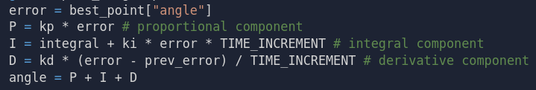
Use Best Point Angle as PID Error Input
a
a
a’
a
a’
New Steering Angle to Publish

Slide 5
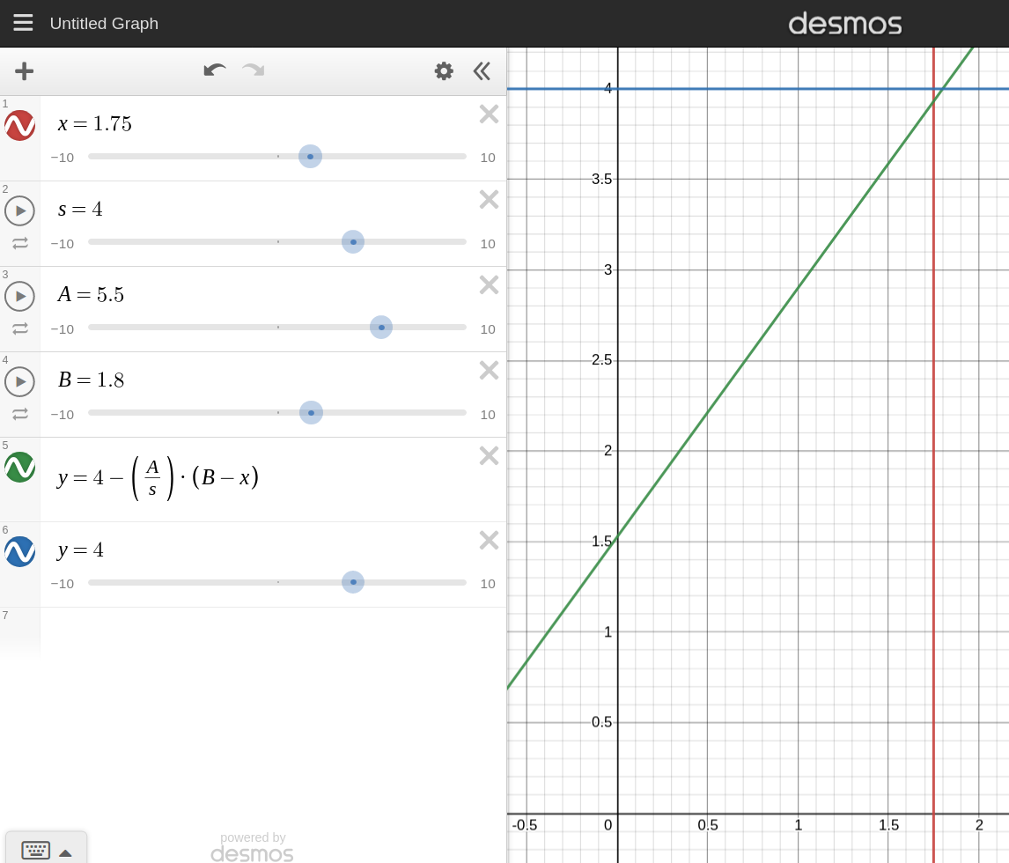
Speed Tuning
Modified P-control algorithm, where the speed of the car is given by a piecewise function corresponding to the straight-ahead distance
Maximum speed if distance is greater than some threshold, otherwise, derate the speed linearly based on the distance
After rounding a corner, do not pop back to maximum speed immediately, but increase the speed linearly over a short time
Improves stability and prevents loss of control when exiting corners

